Slide 1
Practical Statistics for Data science Review
Exploratory Data Analysis

Slide 2
Chapter 2
Data sampling and Distributions

Slide 3
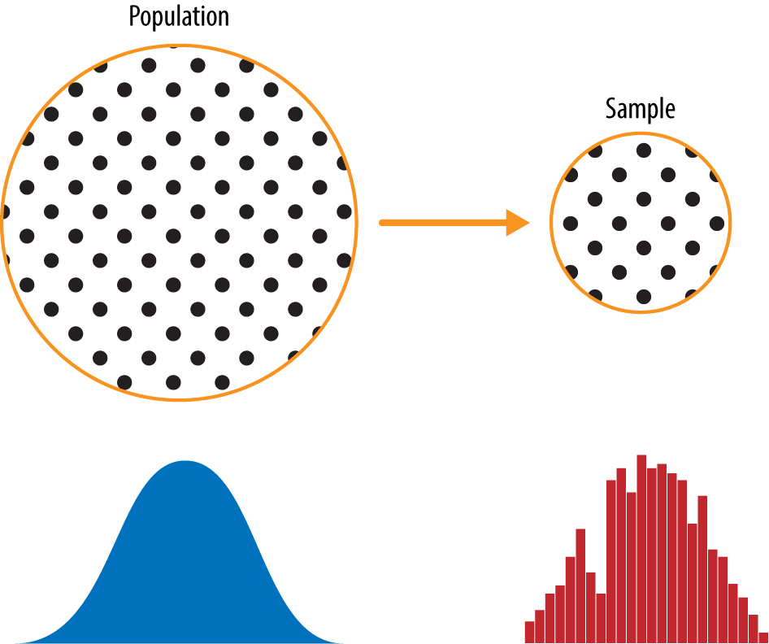
Key Concepts
Population: The larger dataset or idea of a dataset.
Sample: A subset from a larger dataset.
N(n): The size of the population sample.

Slide 4
Random Sampling and bias
Random sampling: Drawing elements into a sample at random. Each available member of the population being sampled has an equal chance of being chosen for the sample at each draw.
With Replacement: observations are put back in the population after each draw for posible future reselection.
Without replacement: observations, once selected, are unavailable for future draws.
Sample Bias: A sample that misrepresents the population. (Poll Example)

Slide 5
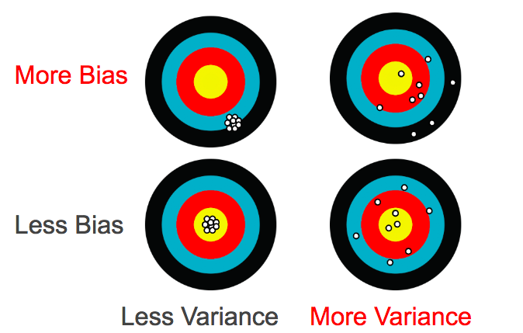
Bias
Statistical bias refers to measurement or sampling errors that are systematic and produced by the measurement or sampling process.

Slide 6
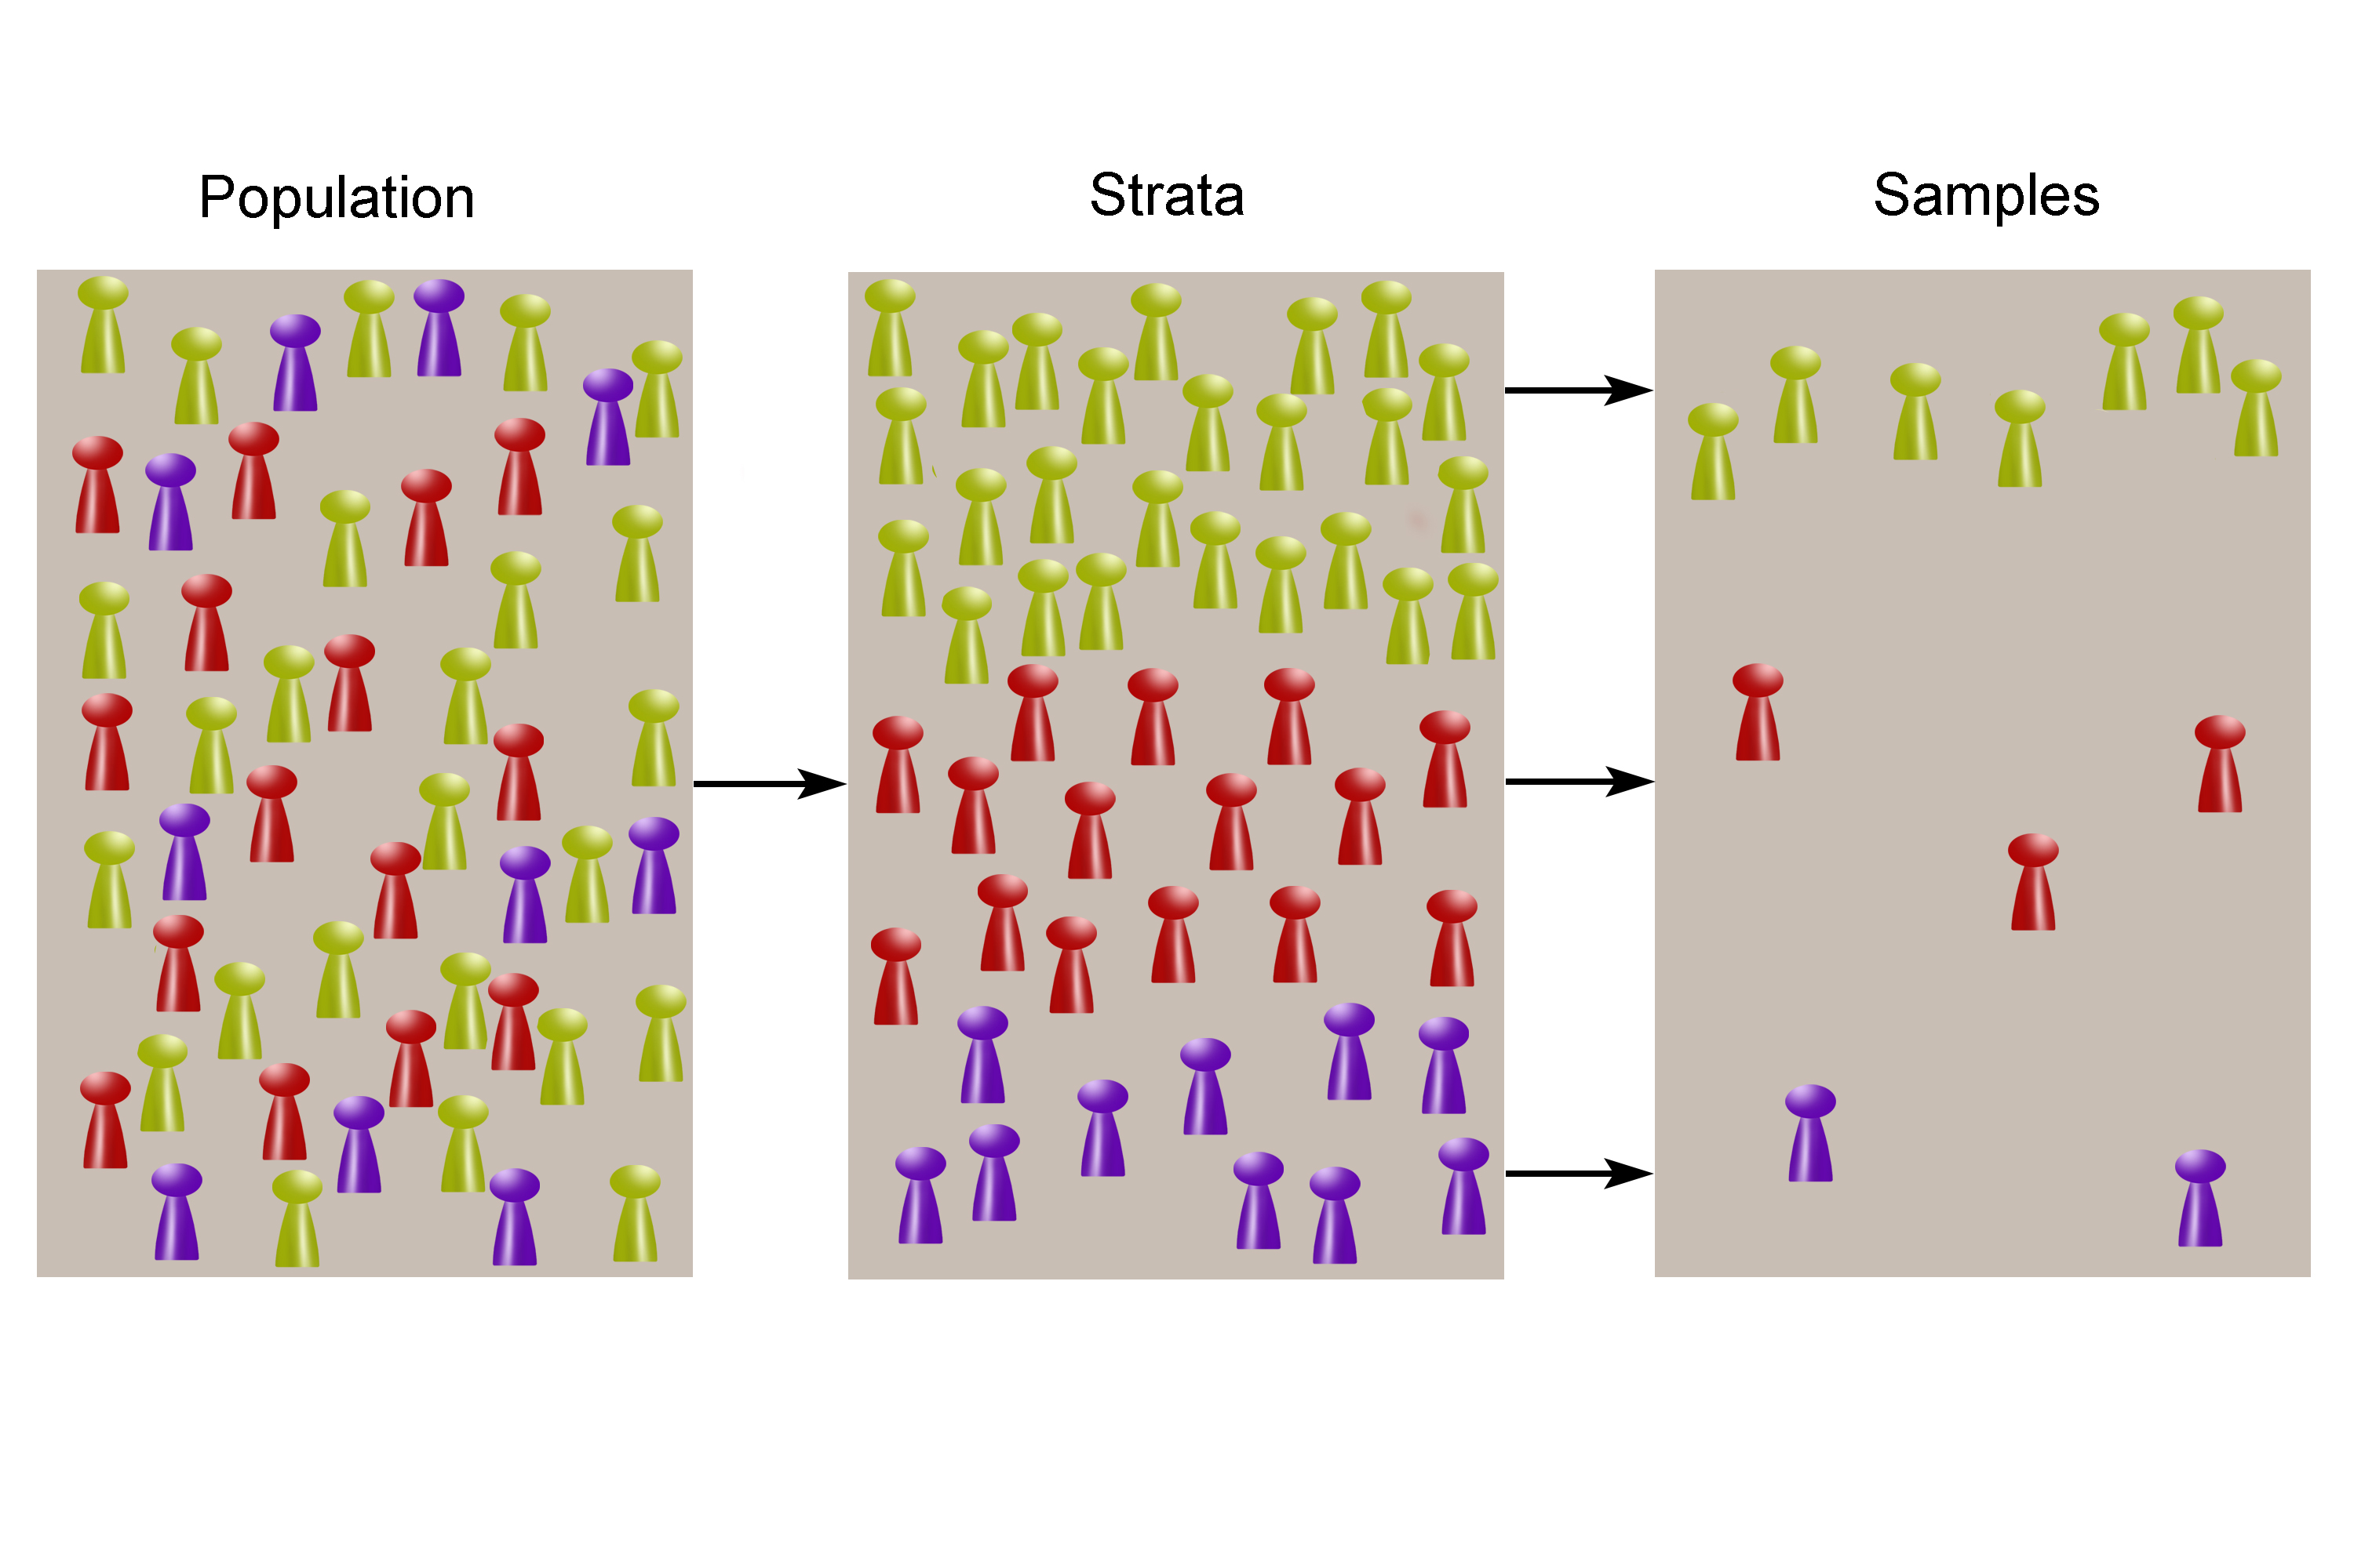
Random selection
In stratified sampling, the population is divided up into strata, and random samples are taken from each stratum.

Slide 7
Sampling key ideas
Even in the era of big data, random sampling remains an important arrow in the data scientist's quiver.
Bias occurs when measurements or observations are systematically in error because they are not representative of the full population.
Data quality is often more important that data quantity, and random sampling can reduce bias and facilitate quality improvement that would be prohibitively expensive.

Slide 8
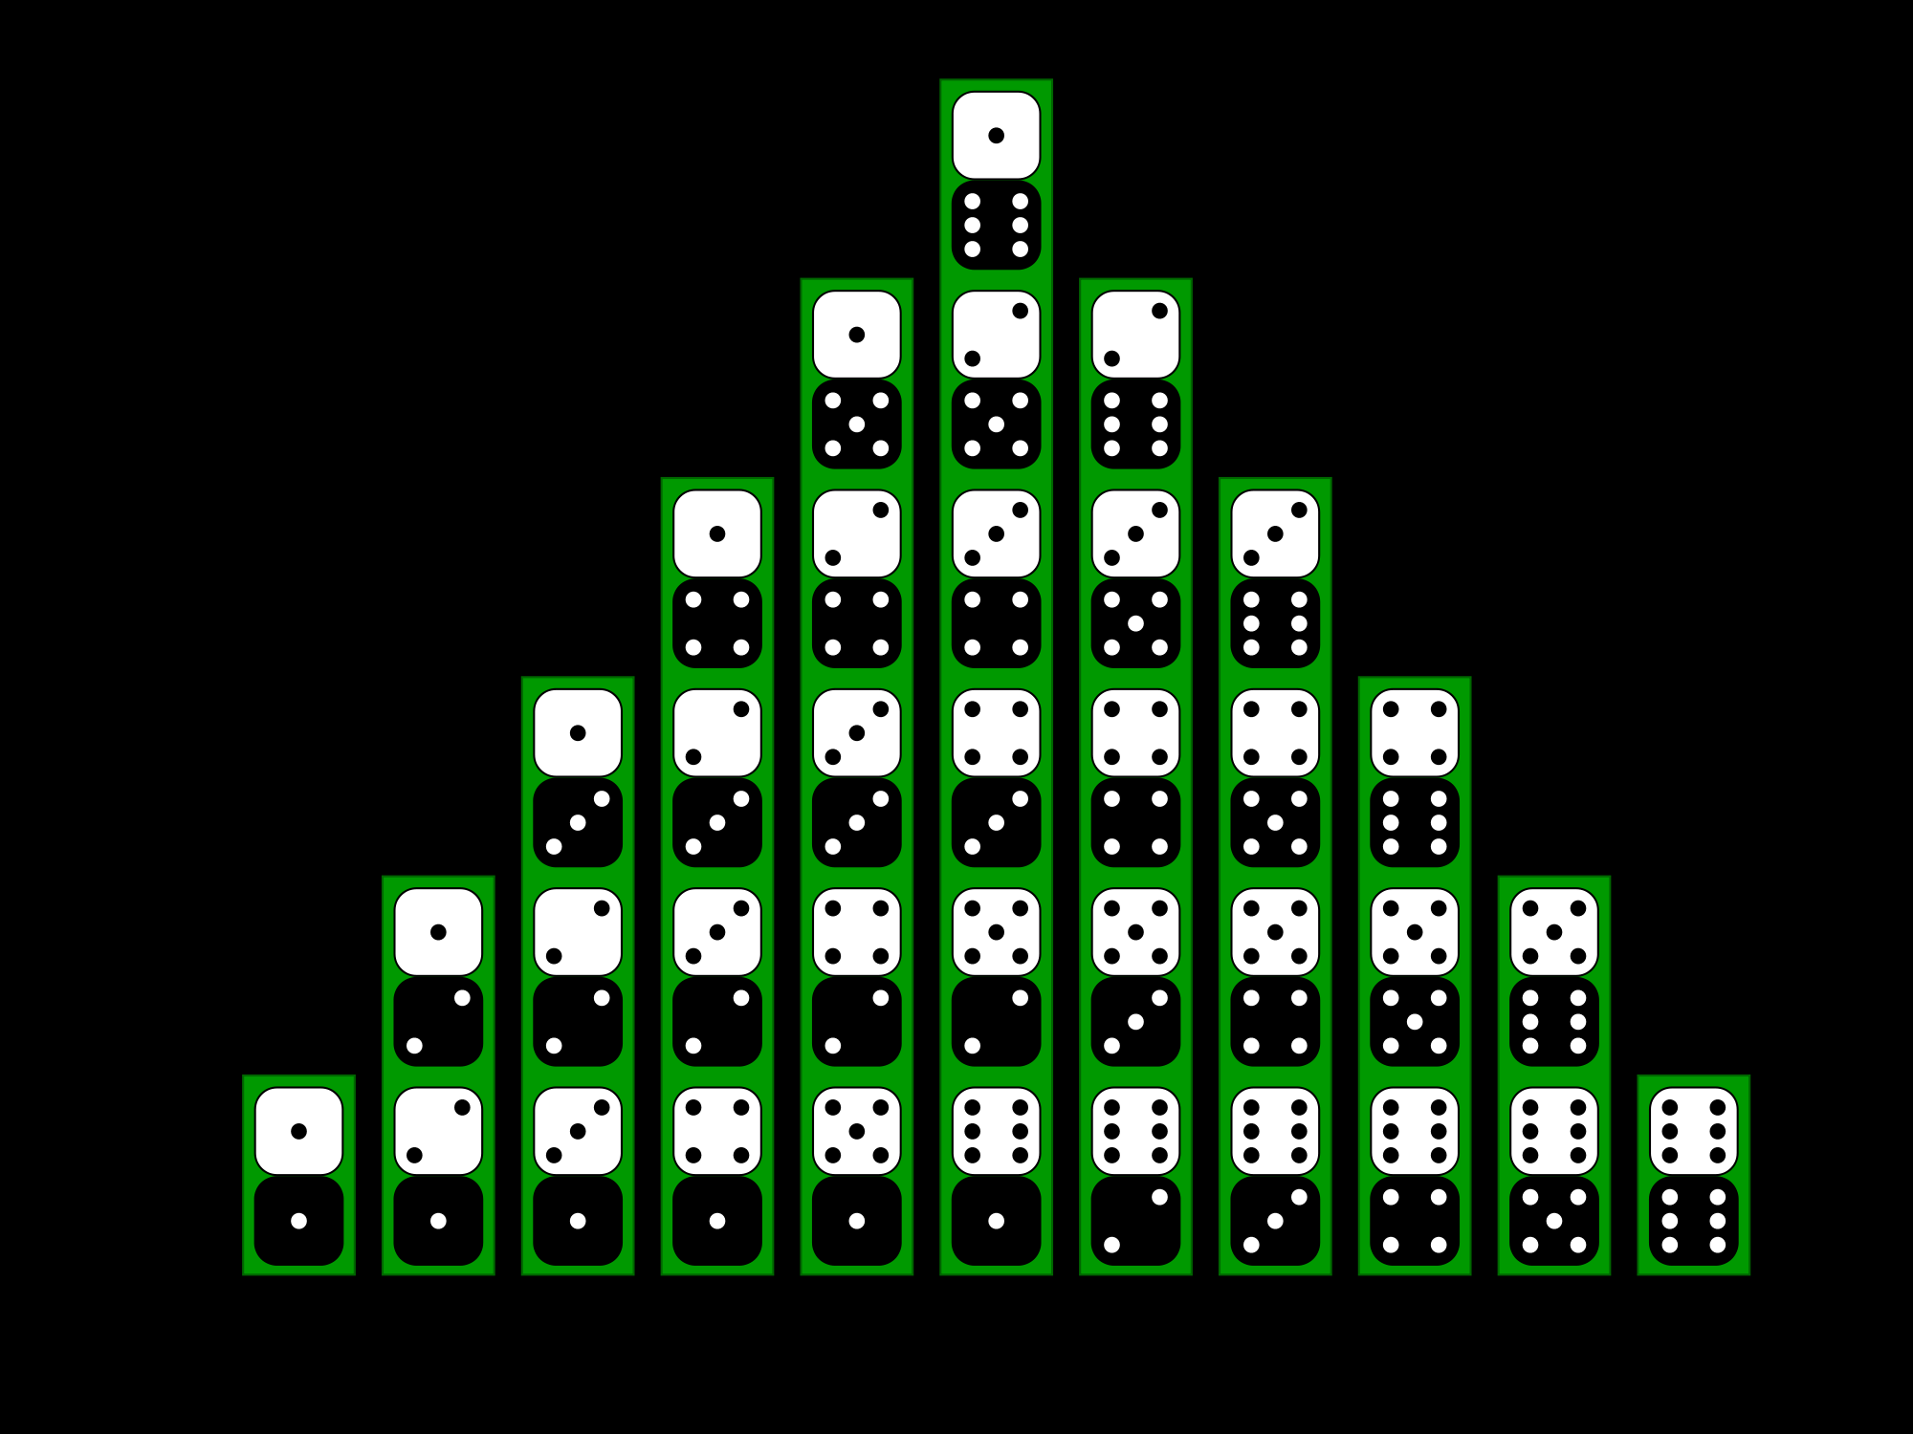
Selection bias
Data snooping: Extensive hunting through data in search of something interesting. “If you torture the data long enough , sooner or later it will confess.”
Vast search effect: Bias or non-reproducibility resulting from repeated data modeling, or modeling data with large numbers of predictor variables.
Regression to the mean: refers to a phenomenon involving successive measurements on a given variable: extreme observations tend to be followed by more central ones.

Slide 9
Sampling distribution of a statistic
The sampling distribution of a statistic refers to the distribution of some sample statistic, over many samples drawn from the same population.
Typically, a sample is drawn with the goal of measuring something or modeling something. We are interested on sampling variability.
The distribution of a sample statistic such as the mean is likely to be more regular and bell-shaped than the distribution of data itself.

Slide 10
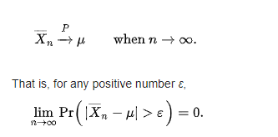
Law of large numbers
The average of the results obtained from a large number of trials should be close to the expected value and will tend to become closer to the expected value as more trials are performed.

Slide 11
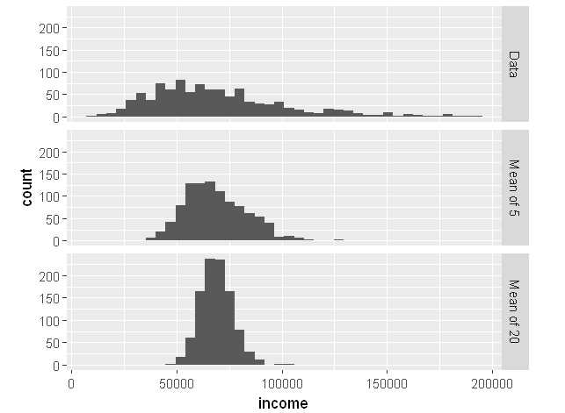
The distribution of a sample statistic such as the mean is likely to be more regular and bell-shaped than the distribution of data itself.

Slide 12

Central limit theorem
The sampling distribution of the mean approaches a normal distribution, as the sample size increases.
Proof*

Slide 13
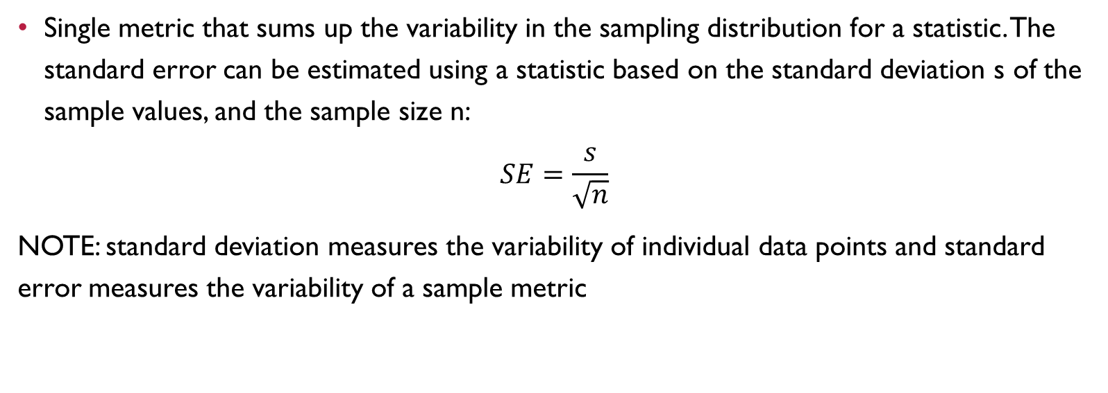
Standard error
Single metric that sums up the variability in the sampling distribution for a statistic. The standard error can be estimated using a statistic based on the standard deviation s of the sample values, and the sample size n:
$$SE=\frac{s}{\sqrt{n}}$$
NOTE: standard deviation measures the variability of individual data points and standard error measures the variability of a sample metric

Slide 14
The bootstrap
An effective way to estimate the sampling distribution of a statistic, is to draw additional samples, with replacement, from the sample itself and recalculate the statistic.
Is a powerful tool for assessing the variability of a sample statistic.
Can be applied in a wide variety of circumstances, without study of mathematical approximations to sampling distributions.
Estimate sampling distributions for statistics where no mathematical approximation has been developed.
When applied to predictive models, aggregating multiple bootstrap sample predictions outperforms the use of a single model.

Slide 15
Bootstrap of the mean algorithm
Draw a sample value, record, replace it.
Repeat n times.
Record the mean of the n resampled values.
Repeat 1-3 B times
Use the B results to :
Calculate their SD.
Produce a histogram or boxplot.
Find confidence interval.

Slide 16
Confidence intervals
Confidence intervals is an alternative to point estimation. It is a good way to deal with uncertainty. Confidence interval are the typical way to present estimates as an interval range.
The more data you have, the less variable a sample estimate will be.
The lower the level of confidence you can tolerate, the narrower the confidence interval will be.
Bootstrap is an effective way to construct confidence intervals.

Slide 17
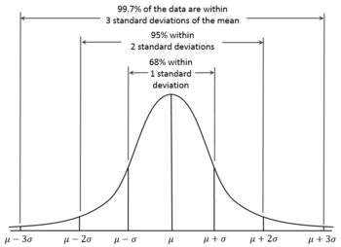

Normal distribution
Bell-shaped distribution, Gaussian distribution.

Slide 18
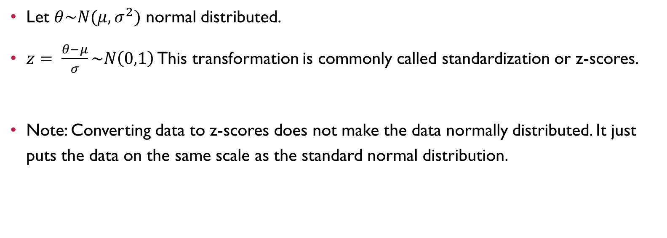
Standard normal
Let $θ\sim N(μ,σ^{2})$ normal distributed.
$z= \frac{θ−μ}{σ}\sim N\left(0,1\right)$ This transformation is commonly called standardization or z-scores.
Note: Converting data to z-scores does not make the data normally distributed. It just puts the data on the same scale as the standard normal distribution.

Slide 19
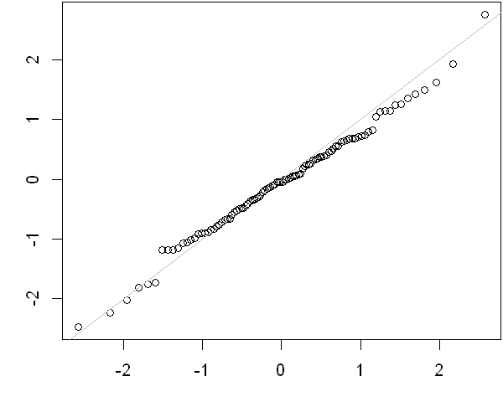
qq-plots

Slide 20
Long-tailed distributions
Data is generally not normally distributed!!!
Tail: The long narrow portion of a frequency distribution, where relatively extreme values occur at low frequency.
Skew: Where one tail of a distribution is longer than the other. (Asymmetry)

Slide 21
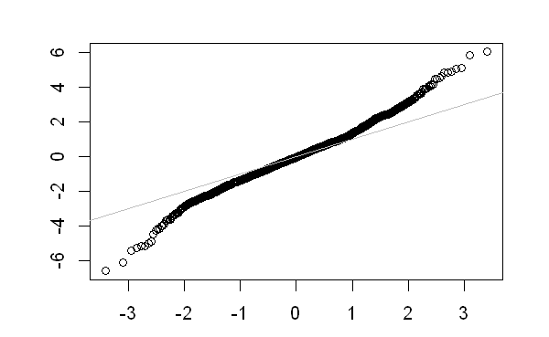
Netflix stocks QQ-plot

Slide 22

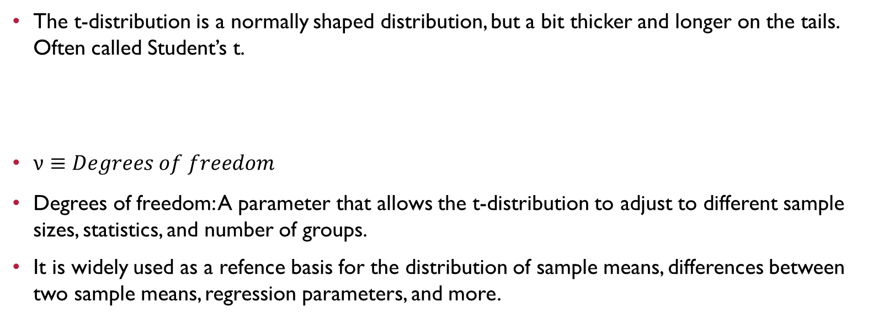
Student’s t-distribution
The t-distribution is a normally shaped distribution, but a bit thicker and longer on the tails. Often called Student’s t.
$ν≡Degrees of freedom$
Degrees of freedom: A parameter that allows the t-distribution to adjust to different sample sizes, statistics, and number of groups.
It is widely used as a refence basis for the distribution of sample means, differences between two sample means, regression parameters, and more.

Slide 23
Binomial distribution
Yes/No (binomial) outcomes lie at the heart of analytics since they are often the culmination of a decision or other process.
Trial: An event with a discrete outcome.
The binomial distribution is the frequency distribution of the number of successes (x) in a given number of trials (n) with specified probability (p) of success in each trial.
With large n, and provided p is not to close to 0 or 1, the binomial distribution can be approximated by the normal distribution. (proof*)

Slide 24
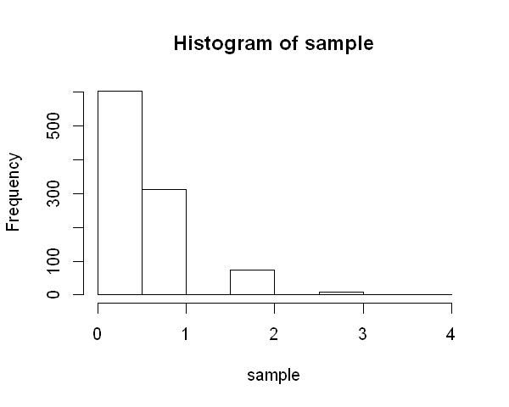

Binomial distribution

Slide 25
Poisson distribution
The Poisson distribution tell us the distribution of events per unit of time or space when we sample many such units.
“Internet traffic that arrives on a server in any 5-second period”
“Number of car that cross a bump in any 5-minutes period”

Slide 26
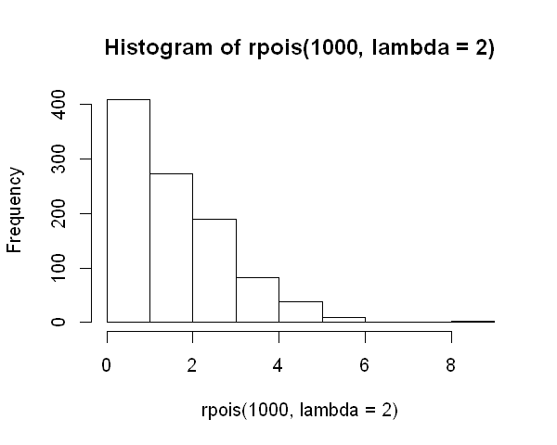

Poisson distribution

Slide 27
Exponential distribution
Models the distribution of the time between events.
“Time between visits to a website or between cars arriving at a toll plaza”
“Time required per service call due a product failure”

Slide 28
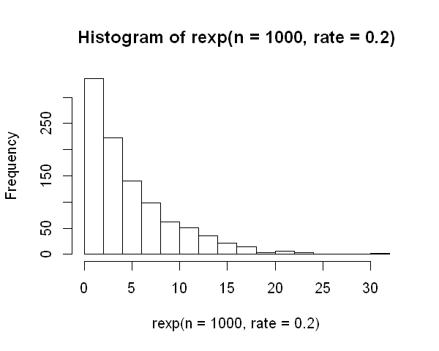

Exponential distribution

Slide 29
Weibull distribution
The Weibull distribution is an extension of the exponential distribution, in which the event rate is allowed to change.
Increasing probability of device failure, aircraft failure.

Slide 30
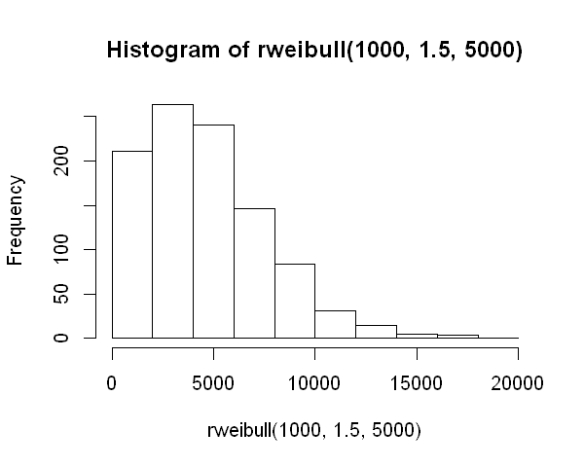

Weibull distribution

Slide 31
Summary
Knowledge of various sampling and data generating distributions allows us to quantify potential errors in estimate that might be due to random variation.
Bootstrap is an attractive “one size fits all” method to determine possible error in a sample estimates.

